Slide 1
Implementing Real-Time Analysis with Hadoop in Azure HDInsight 02 | Using Storm for Streaming Data
Graeme Malcolm | Snr Content Developer, Microsoft

Slide 2
What is a Stream?
What is Apache Storm?
How is Storm Supported in Azure HDInsight?
What is a Storm Topology?
How is Event Data Defined?
How Does Storm Distribute Stream Processing?
How Does Storm Guarantee Message Processing?
How Do I Aggregate Data in a Stream?

Slide 3
What is a Stream?

Slide 4

01100101
01100101
01100101
01100101
01100101
01100101
01100101
01100101
01100101
A unbounded sequence of event data
Stream processing is continuous
Aggregation is based on temporal windows

Slide 5
What is Apache Storm?

Slide 6
An event processor for data streams
Defines a streaming topology that consists of:
Spouts: Consume data sources and emit streams that contain tuples
Bolts: Operate on tuples in streams
Storm topologies run continuously on streams of data
Real-time monitoring
Event aggregation and logging
Spout
Bolt

Slide 7
How is Storm Supported in Azure HDInsight?

Slide 8
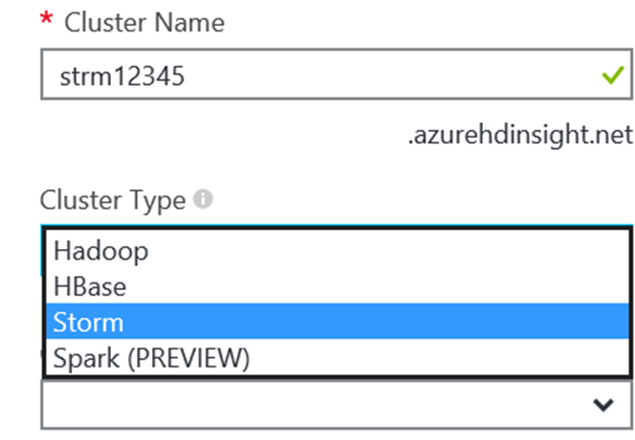
HDInsight supports an Storm cluster type
Choose Cluster Type in the Azure Portal
Specify ClusterType in PowerShell
Creates a Windows or Linux-based Hadoop cluster that includes Storm
Can be provisioned in a virtual network
New-AzureHDInsightCluster -ClusterType Storm

Slide 9
Provisioning a Storm Cluster

Slide 10
What is a Storm Topology?

Slide 11
Spouts emit tuples in streams
Spouts can emit multiple streams
Bolts process tuples
Bolts can also emit tuples
There can be multiple spouts and bolts in a topology
Bolts can process multiple streams
Spout
Bolt
Bolt
Bolt
Spout
Bolt
Notes:
http://storm.apache.org/documentation/Concepts.html

Slide 12
How do I Create a Topology?

Slide 13

Implement Spout and Bolt classes
Native language of Storm is Java
Microsoft SCP.NET package enables development in C#
Use a TopologyBuilder class to connect the components
Build and package the code, and submit the topology to a Storm cluster
TopologyBuilder tb = new TopologyBuilder();
tb.setSpout ("spout", myspout,…);
tb.setBolt("bolt", mybolt…).shuffleGrouping("spout");
public class myspout
{
...
}
public class mybolt
{
...
}
Notes:
http://storm.apache.org/documentation.html
https://github.com/hdinsight/hdinsight-storm-examples/blob/master/SCPNet-GettingStarted.md

Slide 14
How is Event Data Defined?

Slide 15
Declare schema for each stream in each component
Java OutputFieldsDeclarer class defines output schema for a stream
Microsoft SCP.NET class templates include input and output schema declarations for spouts and bolts
Field1 | Field2 | Field3
Integer | String | Integer
Spout
Output
Input
Input
Output
Bolt
Bolt

Slide 16
Creating a Storm Topology with C#

Slide 17
How Does Storm Distribute Stream Processing?

Slide 18

Master node runs Nimbus
Assigns processing across the cluster
Worker nodes run Supervisor
Manages processing on the node
Cluster coordination is managed using Zookeeper
Apache project for distributed processing

Slide 19
A topology has one or more worker processes
A worker process spawns one or more executors (threads) per component
Set using parallelism hint
Each executor runs one or more task
Topology

Worker Process
Executor
Executor
Task
Task
TopologyBuilder tb = new TopologyBuilder();
tb.setSpout ("spout", myspout, 1, …);
tb.setBolt("bolt", mybolt, 3, …).shuffleGrouping("spout");


Executor
Executor
Task
Task
Notes:
https://storm.apache.org/documentation/Understanding-the-parallelism-of-a-Storm-topology.html

Slide 20
Use stream groupings to determine affinity between tasks
Shuffle grouping
Fields grouping
Others
All, Global, …
TopologyBuilder tb = new TopologyBuilder();
tb.setSpout ("spout", myspout, 1, …);
tb.setBolt("bolt", mybolt, 3, …).shuffleGrouping("spout");
Topology

Worker Process
Executor
Executor
Task
f1=A
Task
TopologyBuilder tb = new TopologyBuilder();
tb.setSpout ("spout", myspout, 1, …);
tb.setBolt("bolt", mybolt, 3, …).fieldsGrouping("spout", "f1");

f1=B

Executor
Executor
Task
f1=C
Task
Notes:
https://storm.apache.org/documentation/Concepts.html

Slide 21
Using the Parallelism Hint

Slide 22
How Does Storm Guarantee Message Processing?

Slide 23


Non-Transactional (no Ack)
Enforces at most once semantics
Simplest programming model
Possible data loss
Non-Transactional (with Ack)
Enforces at least once semantics
Requires explicit retry logic
Transactional
Enforces exactly once semantics
Works well for batches
Use TransactionalTopologyBuilder
Implement a committer bolt
seq, tuple
seq, tuple
seq, tuple
Acker



Slide 24
Implementing Guaranteed Message Processing

Slide 25
How Do I Aggregate Data in a Stream?

Slide 26
01100101
01100101
01100101
01100101
01100101
01100101
01100101
01100101
01100101
Events are aggregate within temporal windows
Use a tumbling window to aggregate events in a fixed timespan
For example: every hour, count the events in the preceding hour
Use a sliding window to aggregate events in overlapping timespans
For example: every 10 minutes, count the events in the preceding hour

Slide 27
Cache field values from each tuple
Configure a Tick Tuple for the window duration
On each tick, start a new window:
For a tumbling window:
Aggregate cached fields
Delete all cached fields
For a sliding window
Delete stale fields
Aggregate remaining fields


∑
3
1
6
2

Slide 28
Implementing a Sliding Window

Slide 29
What is a Stream?
What is Apache Storm?
How is Storm Supported in Azure HDInsight?
What is a Storm Topology?
How is Event Data Defined?
How Does Storm Distribute Stream Processing?
How Does Storm Guarantee Message Processing?
How Do I Aggregate Data in a Stream?

